Slide 1
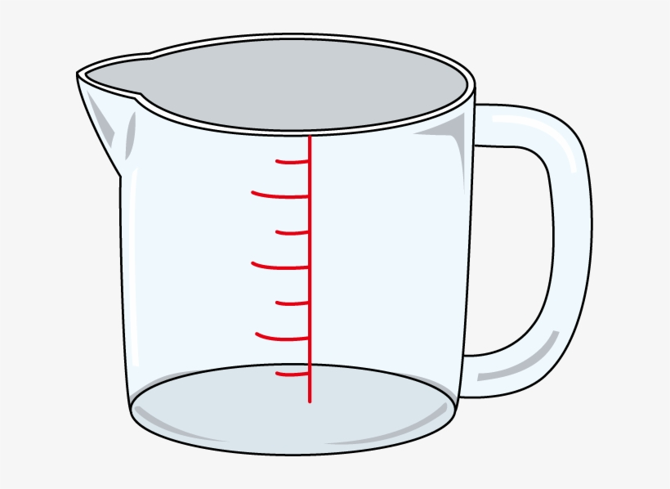

Metrics Conversion
Program that allows you to convert units of measure from the US to European countries For example, converting feet to meters.
By: Victoria Salo and Laura Ramirez
https://github.com/ksu-is/Metrics-Conversion

